Slide 1
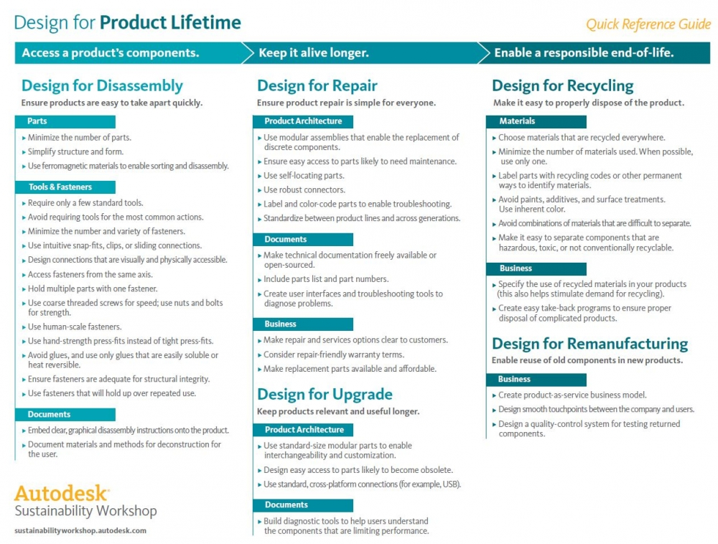

Slide 2
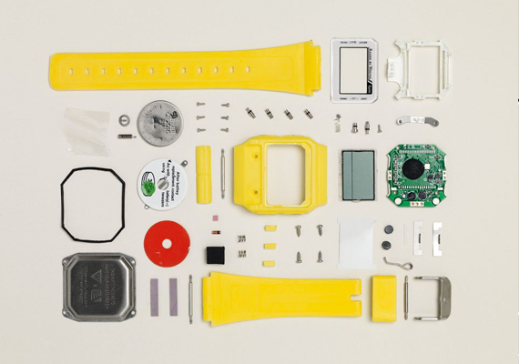
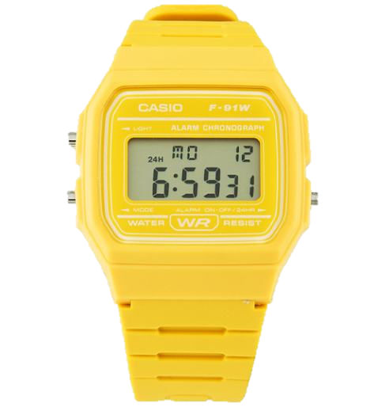
Applying New Technologies: Investigating Engineering Products
Name:
How is a Casio watch in manufactured:
Materials used in the manufacture of a Casio watch:
GCSE Engineering @Hope Valley College

Slide 3
Applying New Technologies: Investigating Engineering Products
Name:
Casio Watch Product redesign to improve product life cycle
Redesigned: Designed to improve product life cycle
GCSE Engineering @Hope Valley College

Slide 4
How a Casio Watch is manufacture and materials is it made from:
Watch Strap and seals: polyurethane resin (a type of thermoplastic) which is strong, durable, flexible and chemically resistant. It is manufactured by casting resin in CNC machined moulds, the mixture of the resin and casting is all computer controlled to ensure accuracy and repeat quality
Watch face frame parts: Made from High impact polystyrene and manufacture by injection moulding. This is a very expensive manufacturing process and only is cost effective is thousands are manufactured. This is ideal for a Casio watch. The moulds are CNC milled and routed out of Steel and the injection moulding process injects molten plastic into the mould. This is a very accurate process and the parts manufactured need no finishing after manufacture. High impact polystyrene is a strong and durable materials that is easy to mould into complex shapes.
Watch PCB: The PCB is made from rigid laminate consisting of a woven glass epoxy base clad with copper. The circuit design in photo transferred on to the copper side via UV light and then is etched in Ferric Chloride to remove all but the circuit tracks and component pads. The circuit is the then CNC milled to size and a CNC machine will surface mount solder the components onto the circuit board.
Screws, connectors and strap pivots: Blanks of strong ductile metals like steel are rolled between threaded dies. Large threads are hot rolled followed by finishing and smaller threads are straight cold rolled to desired finish. Cold rolling attributes more strength and toughness to the threaded parts. This production method is widely used for mass production of fasteners like bolts, screws etc.
Back of the Watch: Made for stainless steel and is press formed In press forming, a pair of tools called a “die” is mounted inside a press and then a material (such as metal) is placed inside the die. The press then applies high pressure (3000 tons of force or higher on large presses) and the material is formed to match the shape of the die. In other words, press forming is a forming technology where a pressing force is applied to a material to deform it (by bending, stretching, etc.) to match the size and shape of the die, and the material then maintains that shape forever.
Design for disassembly ideas:
Not surface mount soldering
One moulded part for strap and case
No clue used
One type for screw fixing used
Click fittings used

Slide 5
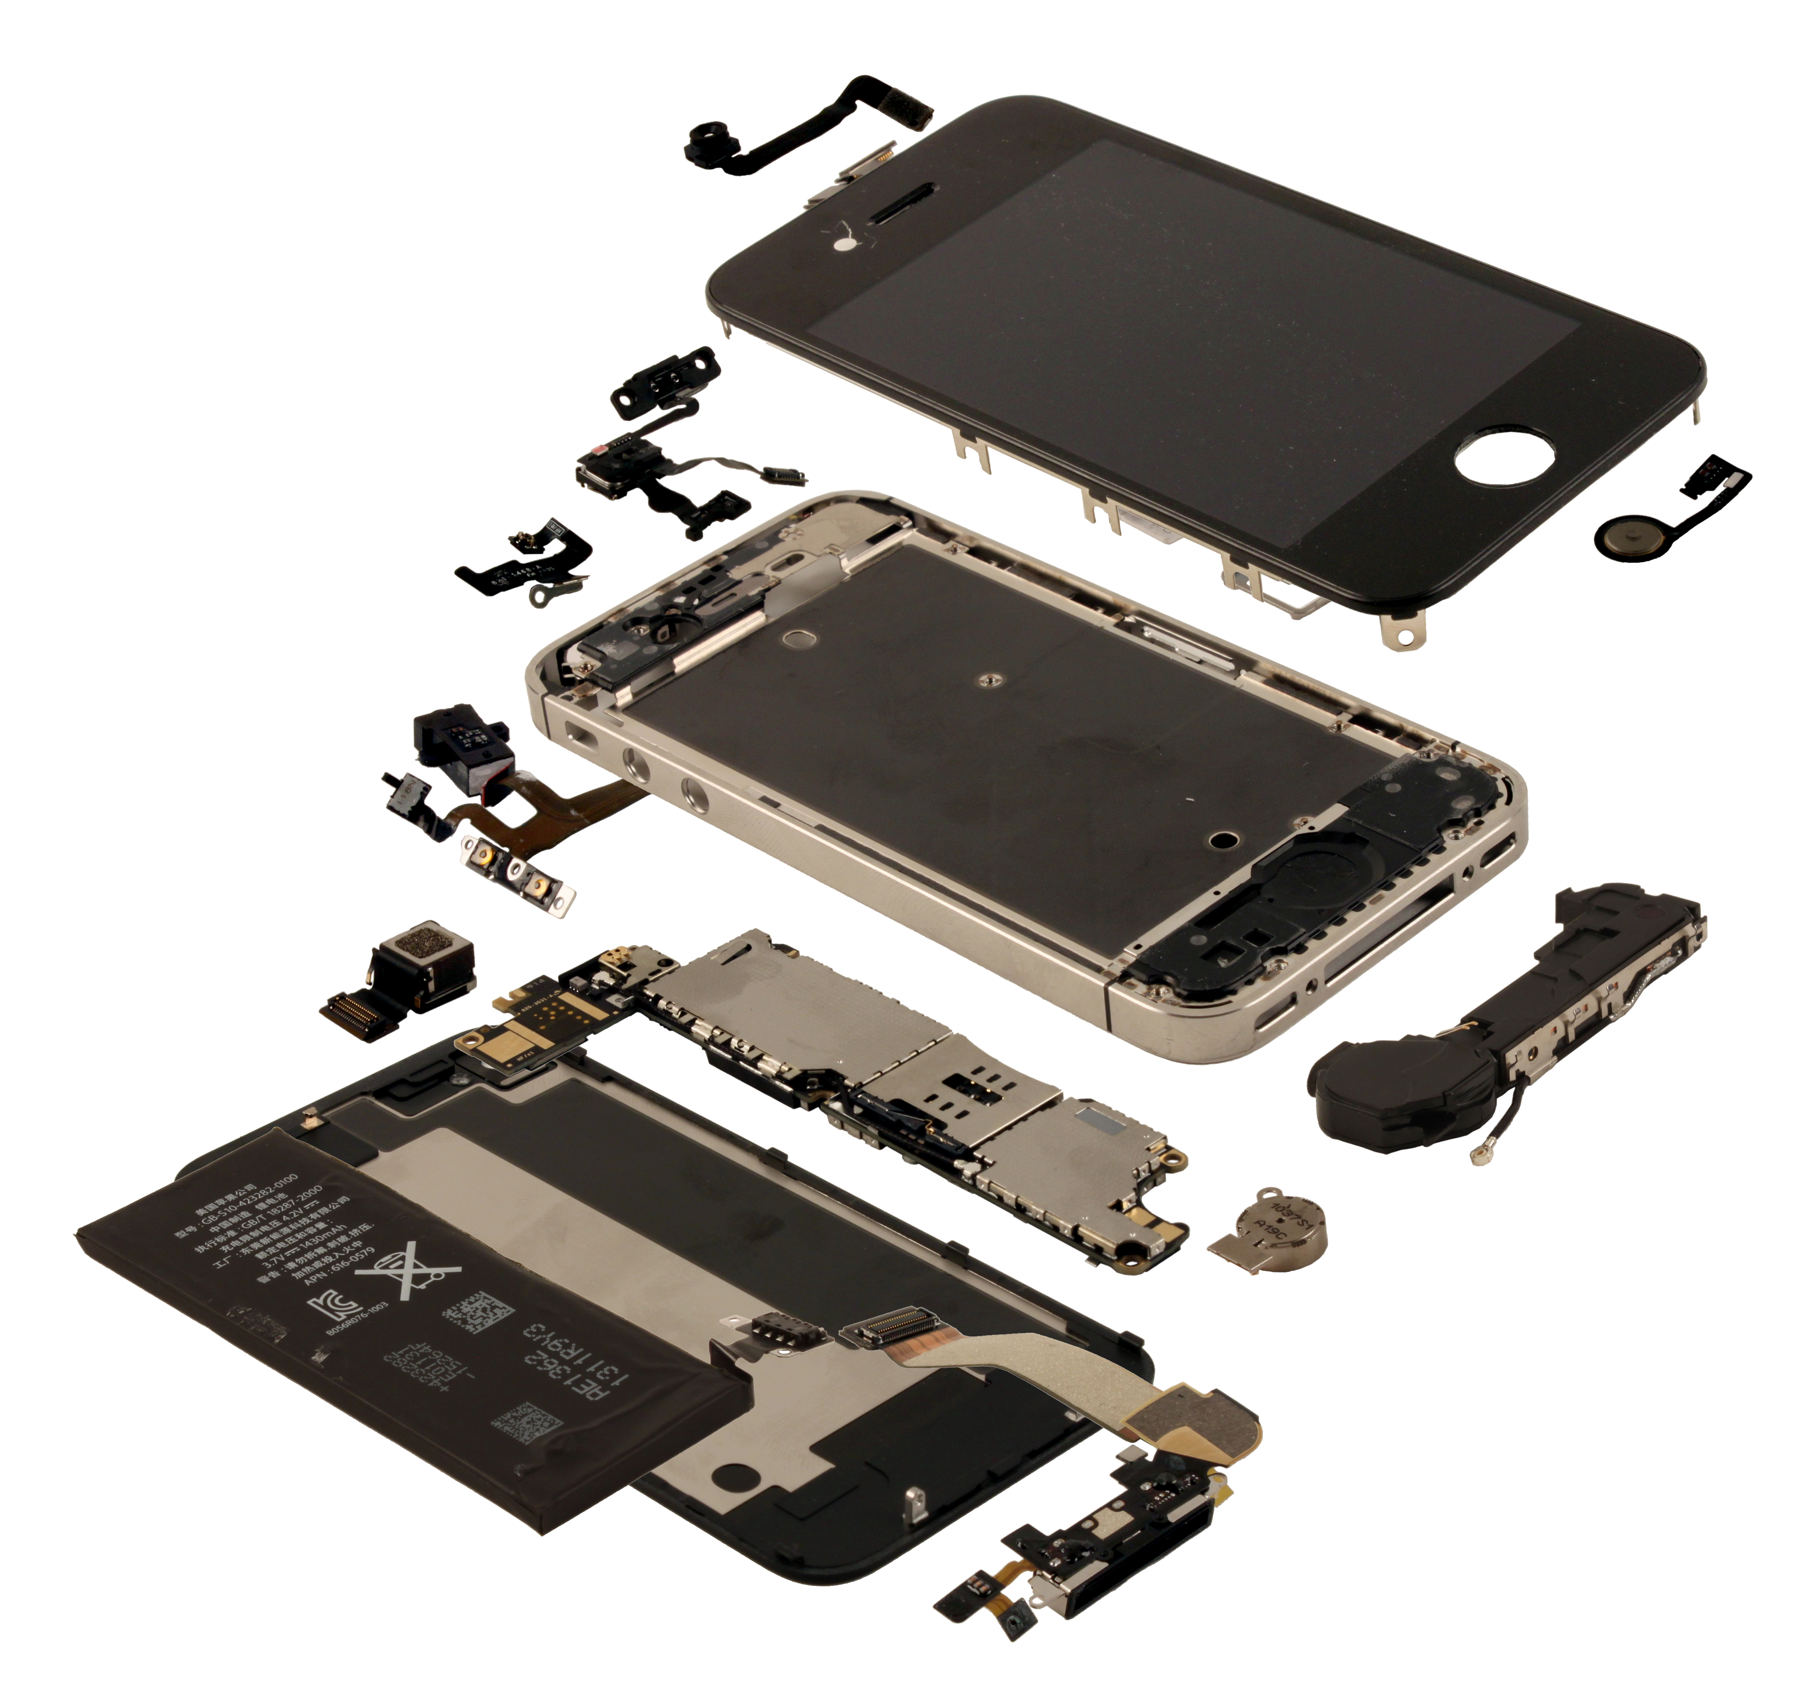
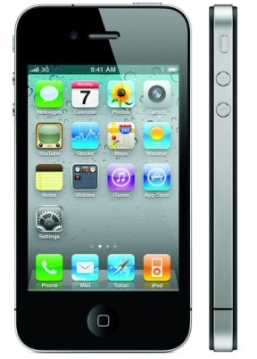
Applying New Technologies: Investigating Engineering Products
Name:
How an iPhone is manufactured:
Materials used in the manufacture of an iPhone :
GCSE Engineering @Hope Valley College

Slide 6
Applying New Technologies: Investigating Engineering Products
Name:
iPhone Product redesign to improve product life cycle
Redesigned: Designed to improve product life cycle
GCSE Engineering @Hope Valley College

Slide 7
How a iPhone is manufacture and materials is it made from:
iPhone Screen: Sapphire glass is extreme hard and tough materials. The process starts inside these furnaces, where extreme heat and pressure turn aluminum oxide into the sapphire crystal. The temperature is churned up to nearly 4,000 degrees Fahrenheit, enabling the materials to melt together. The melted material is then put through a series of cooling cycles over a period of roughly two weeks, during which time the sapphire crystallizes. What you're left with is a cylindrical piece of sapphire, called a sapphire boule. The sapphire must be separated into paper-thin sheets that can be used for smartphone screens and this process is called proton induced exfoliation (PIE) where the sapphire separates into very thin sheet.
PCB: The PCB is made from rigid laminate consisting of a woven glass epoxy base clad with copper. The circuit design in photo transferred on to the copper side via UV light and then is etched in Ferric Chloride to remove all but the circuit tracks and component pads. The circuit is the then CNC milled to size and a CNC machine will surface mount solder the components onto the circuit board.
iPhone body: The iPhone case is made from aluminum and is machine on a CNC router to shape. The CNC router is used to ensure the casing is extremely accurate.
Design for disassembly ideas:
Not surface mount soldering
Easy to maintain – Not hard to open and change parts.
No glue used
One type for screw fixing used
Click fittings used
See design for disassembly phone example
Plastic surrounds: These are made from urea-formaldehyde as the are more resistant to heat, so when the iPhone gets warm they don’t change shape. The moulds are CNC milled and routed out of Steel and the injection moulding process injects molten plastic into the mould. This is a very accurate process and the parts manufactured need no finishing after manufacture.

